Slide 1
Principles of Information Technology
Resume Writing
Principles of IT: Resume Writing

Slide 2
What is a Resume?
A resume is a summary of your experiences and skills relevant to the field of work you are entering.

Slide 3
The Purpose of a Resume
To highlight your accomplishments and prove that you are qualified for the position
To get an interview
To eventually get the JOB!
JOB

Slide 4
Sections of the Resume
Name, Address, Phone, and Email Address
Minimum 14-point font size
Objective/Summary
Optional
Education
Work Experience
If no work experience, leave off and use volunteer work/activities
Volunteer Work/Activities
Skills
References

Slide 5
What to include in your Resume
School attended
Paid work experience
Volunteer work
Awards
Organizations
Workshops/Seminars
Strengths
Leadership positions

Slide 6
Preparing your Resume
Make a list of your paid/volunteer work experiences
Try to find accurate dates for the duration of time worked
Write down any leadership positions or awards you have received

Slide 7
After the list…
List duties that you performed on the job or in your any of your organizations
Describe your accomplishments in detail
Use action verbs
An action verb expresses achievement or something a person does in a concise, persuasive manner
Used when describing your job duties/functions

Slide 8
Examples
Volunteered at Petsmart
Organized adoption event for dogs
Maintained daily log of feeding schedule for all of the animals
Most Outstanding Freshman Award
Developed idea to adopt a family for the school year
Obtained a 4.0 GPA freshmen year
Tutored students in math and reading

Slide 9
References
Find people who will validate your work experience, skills, and loyalty
Current/former employers, teachers, mentors, church members
Contact prospective reference and ask for permission
Create list of at least three references
Include name, phone number, address, and email address

Slide 10
Format
White space
Resume should not look crowded
Bold job titles
Use bulleted list for duties and descriptions
One-inch margins
Use reverse chronological order
Your resume should only be one page

Slide 11
Resume Tips
Try not to use information from more than five years back
Use the most relevant information for the job that you are applying for
Bold all section headings
All fonts should be the same—except your name at the top of the resume
PROOFREAD, PROOFREAD, PROOFREAD

Slide 12
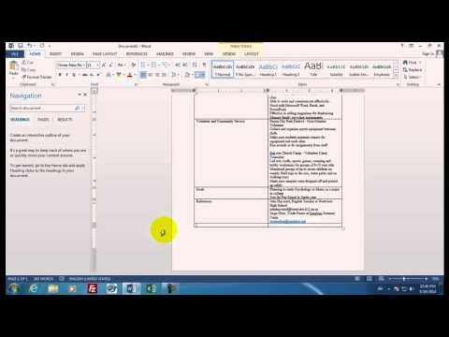
Writing a Resume

